Slide 1

EcoShelf: Minimizing Food Waste
Predicting Retail Demand to Minimize Food Waste.
Presented by Precious Ayoola.

Slide 2



Executive Summary
EcoShelf addresses the challenge of balancing product availability with waste reduction in retail grocery.
Demand Forecasting
ML Model Performance
Financial Impact
Improved accuracy for high-risk perishable departments (Grocery & Produce).
Random Forest Regressor reduced forecast error by 87% compared to traditional methods.
Potential annual optimization exceeding $1 million.

Slide 3


The Business Problem: Perishable Losses
Retailers face significant losses from perishable goods due to inaccurate demand forecasting.
Overstocking
Leads to food waste and tied-up capital.
Understocking
Results in lost revenue and reduced customer satisfaction.
EcoShelf aims to improve demand accuracy and reduce overstock-related waste.

Slide 4

Data & Analytical Approach
The analysis utilized the Walmart Store Sales Forecasting dataset, focusing on perishable departments.
Dataset Overview
45 stores, 99 departments
140,000+ historical records
Focus: Dept 92 (Grocery) & Dept 95 (Produce)
Feature Engineering
Seasonal indicators (Week, Month)
Store Size, Holiday flag
Temperature, Fuel Price, economic variables
Modeling Approaches
Seasonal baseline (historical weekly average)
Random Forest Regressor
Evaluation Metrics
Mean Absolute Error (MAE)
Weighted MAE (holiday-weighted)
$R^2$ score

Slide 5
Key Findings: Model Accuracy
The Random Forest model significantly reduced forecast error compared to traditional methods.
Model
MAE
Seasonal Baseline
36,560
Random Forest
4,732
The Random Forest model reduced forecast error by approximately 31,827 units per week, an 87% improvement. It achieved an $R^2 = 0.718$, explaining nearly 72% of sales variation.

Slide 6
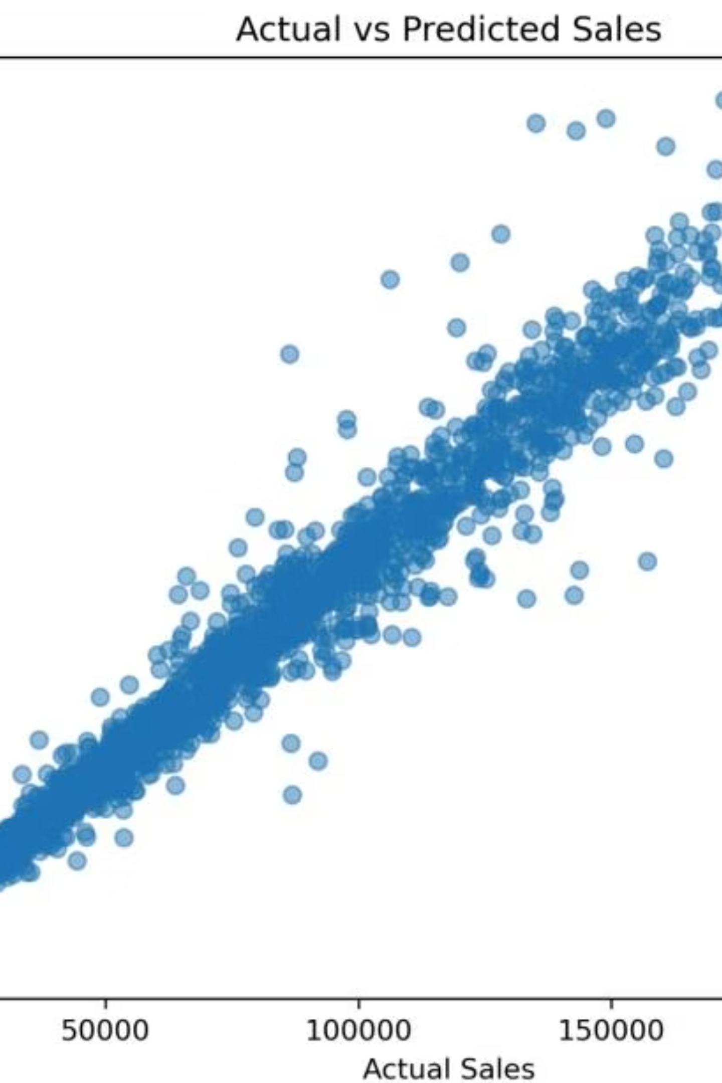
Model Performance: Actual vs. Predicted Sales
The scatter plot below illustrates the strong predictive performance of the Random Forest model.
Observations: Points clustered along the diagonal indicate accurate predictions. The model shows a high $R^2$ (0.967) and low MAE (≈4,732), demonstrating reliable weekly demand forecasting.

Slide 7
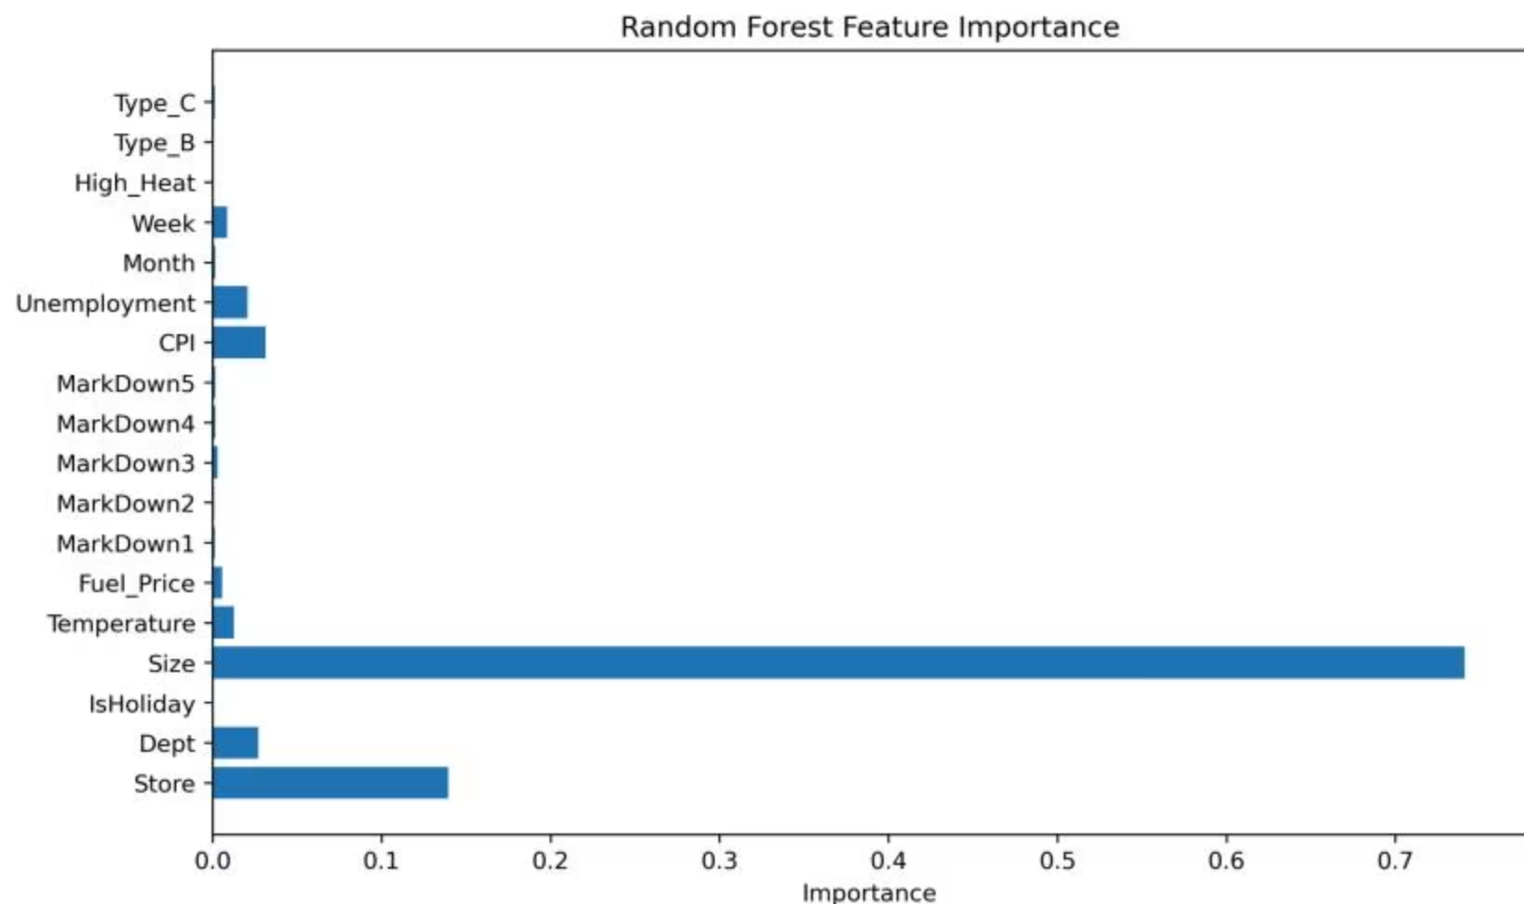
Feature Importance
Understanding which factors drive sales is crucial for effective forecasting.
Key Drivers of Demand:
Store Size: The most influential factor.
Week of Year: A strong seasonal driver.
Limited Impact: Environmental and economic variables had minimal effect on total sales volume.
This highlights the importance of structural store characteristics and seasonal cycles for inventory planning.

Slide 8


Financial & Sustainability Impact
Improved forecast precision translates directly into significant financial savings and environmental benefits.
31,827
$95,000
$4.9M
Units per week error reduction.
Weekly optimization potential (at $3/unit).
Annual precision improvement.
Even a conservative estimate of 20-25% waste reduction translates to over $1 million annually in cost savings, while also supporting sustainability goals.

Slide 9





Strategic Recommendations
Leverage machine learning for smarter inventory management.
Implement ML Forecasting
For perishable departments to enhance accuracy.
Prioritize Seasonal Cycles
Integrate into replenishment planning.
Monitor Holiday Periods
With heightened forecast review.
Integrate Predictive Outputs
Into inventory ordering systems.
Future Spoilage Analysis
To directly measure waste reduction.

Slide 10

Conclusion: EcoShelf's Impact
EcoShelf demonstrates the power of machine learning in retail demand forecasting.
87% reduction in forecast error, outperforming traditional methods.
Substantial financial optimization potential and support for environmental sustainability.
Data-driven inventory decisions offer a measurable pathway to reducing food waste without sacrificing profitability.
EcoShelf is a step towards a more efficient and sustainable retail future.

